Slide 1
Cepheid
BACKGROUND: CEPHEID JUST INVESTED IN A NEW PRODUCTION LINE (VFAL) WHICH MANUFACTURE PRODUCT 24 HOURS PER DAY
PROBLEM : EFFICIENT CONTROL AND MONITORING DATA COMING OUT FROM THAT PRODUCTION LINE FOR STATISTICS AND DOCUMENTATION
SOLUTION: PRODUCTION ANALYTICS MONITORING SYSTEM

Slide 2
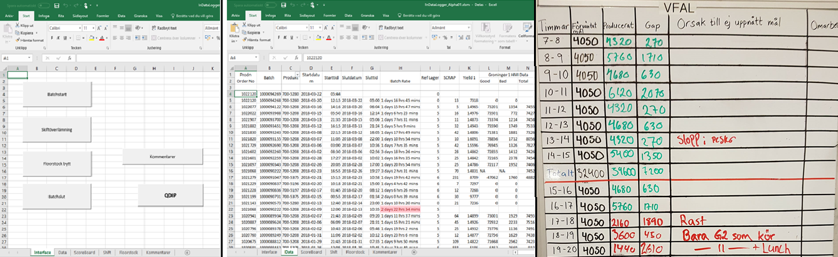
Current gui

Slide 3
VFAL Monitor Requirements
2 parts to the application:
Operations – Data input, used by operators in production
Statistics – Data visualization, used by managers and planners
Operators should spend minimal time using the application. Input of data should be efficient and intuitive.
The application should never hinder or reduce production speed.
Managers and planners want data statistics on everything!

Slide 4
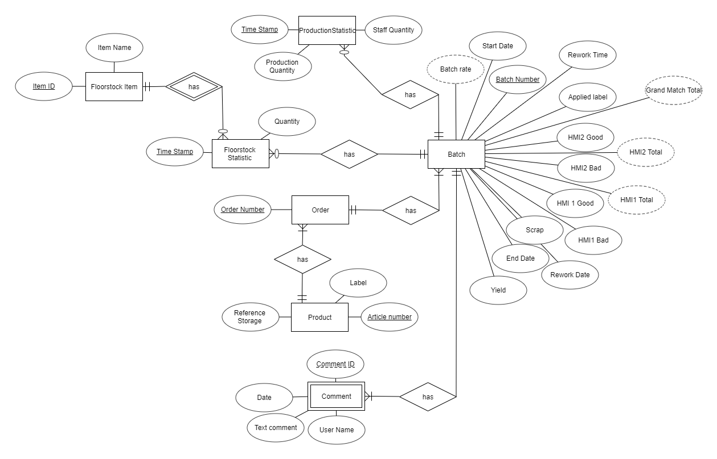

Slide 5
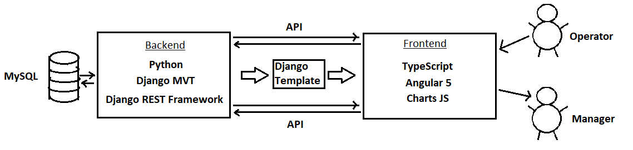
Architechture → Tools → Implementation
Django Backend for the API
Separate Angular Frontend served by ONE Django template
Django for rapid, simple development. Angular for guaranteed scalability.

